Slide 1
LINEAR TRASFORMATIONS and its applications

Slide 2
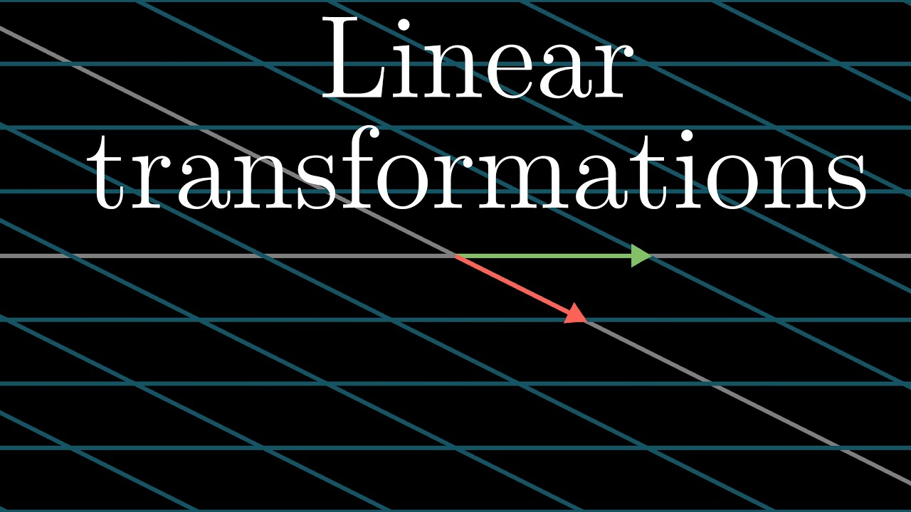

Slide 3
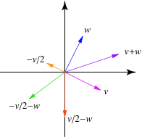
Introduction
linear transformation is a mapping V → W between two modules(for example, two vector spaces) that preserves the operations of addition and scalar multiplication.

Slide 4
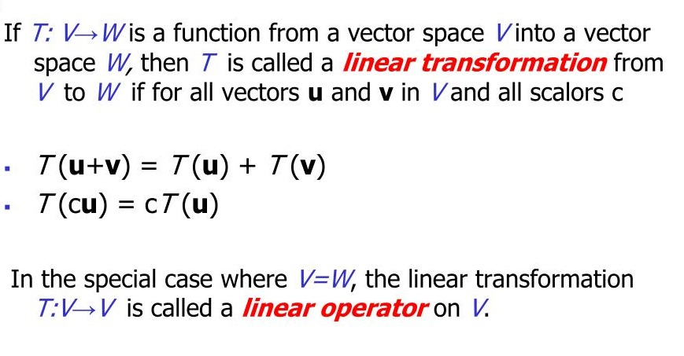
Definition

Slide 5

Examples

Slide 6
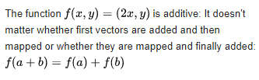

Slide 7


Slide 8
Matrices
If A is a real m × n matrix,then f(x)= Ax describes
a linear map R^{n}→ R^{m}
The matrices of a linear transformation can be represented visually:
Matrix for T relative to B: A
Matrix for T relative to B’: A’
Transition matrix from B’ to B: P
Transition matrix from B to B’: P^{-1}

Slide 9
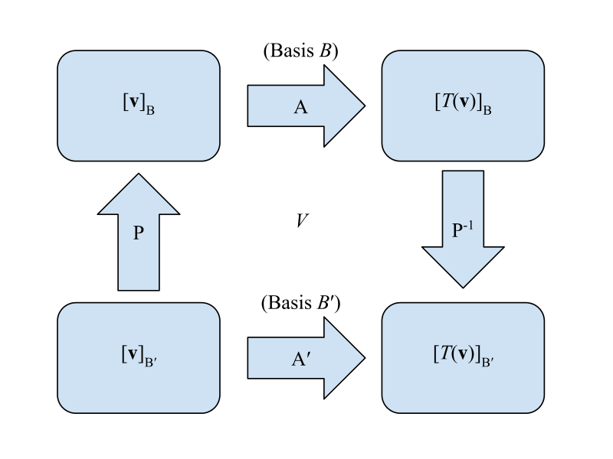

Slide 10
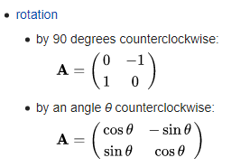
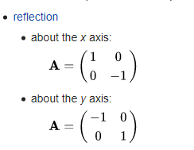
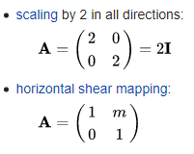
Examples of linear transformation matrices In two-dimensional space R² linear maps are described by 2 × 2 real matrices.

Slide 11
Applications
A specific application of linear maps is for geometric transformations, such as those performed in computer graphics, where the translation, rotation and scaling of 2D or 3D objects is performed by the use of a transformation matrix. Linear mappings also are used as a mechanism for describing change: for example in calculus correspond to derivatives; or in relativity, used as a device to keep track of the local transformations of reference frames.
Another application of these transformations is in compiler optimizations of nested-loop code, and in parallelizing compiler techniques.

Slide 12


